Slide 1
Represents the voice of relative and non-relative caregivers to promote the well-being of children in foster care.
California Alliance of Caregivers
www.cacaregivers.org
Jenn Rexroad Dayna Freier
jrexroad@cacaregivers.org dfreier@cacaregivers.org
530-312-0480 530-219-6604

Slide 2
How Does California Alliance of Caregivers (CAC) Represent the Voice of Caregivers?
Caregiver Day at the Capitol
CAC Statewide Leadership Ambassadors Program
Parents & Caregivers for Wellness- Project Partner
Monthly Child Welfare Policy Roundtable
Continuum of Care Reform Strategic Implementation Meetings
California Department of Social Services (CDSS) & County Welfare Directors Association Meetings
Parents & Caregivers for Wellness
CDSS Workgroups – Education, Intensive Services Foster Care, Legislation Implementation
2019 Legislation & Budget Requests

Slide 3
Balancing the Whole
Meeting Individual Needs Within the Family System
Dayna Freier, MAOL
Program Director
California Alliance of Caregivers

Slide 4
Overview
Past patterns within the family system
02
Seeing the family system with fresh eyes
03
Envisioning how we want the family system to function
04
Practice, practice, practice
05
Performing the way we envisioned
06
Understanding the family as a system
01

Slide 5
Objective
Understanding U Theory
Downloading Past Patterns (Suspending)
Seeing with Fresh Eyes (Redirecting)
Sensing (Letting Go)
Presencing (Connecting)
Crystallizing Vision & Intention (Letting Come)
Prototyping (Enacting)
Performing (Embodying)
Moving From Theory to Practice

Slide 6
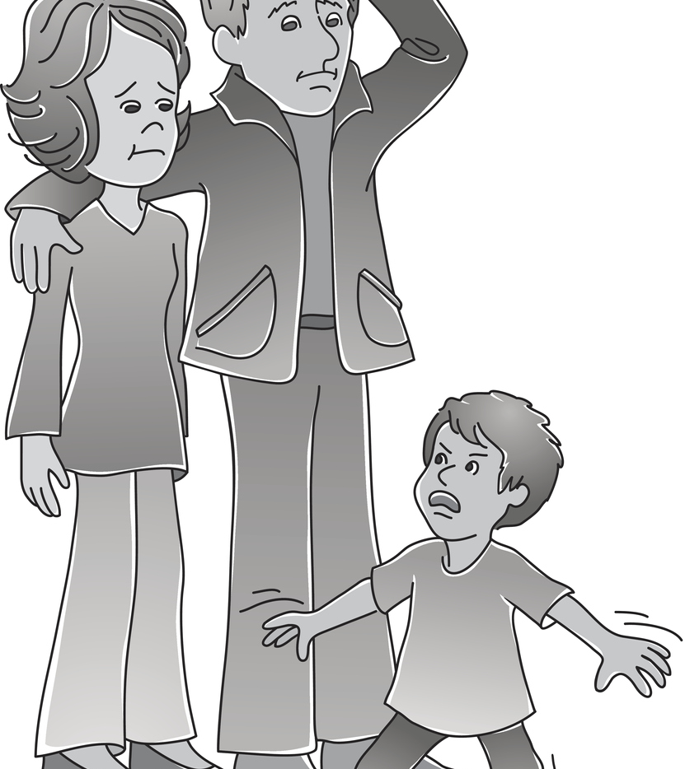
Welcome to the Club
Membership is
Lifelong
Non-Transferable
Will Never Cause Others Envy or Jealousy

Slide 7
family
noun
fam·​i·​ly | \ ˈfam-lē , ˈfa-mə-\
Definition of family
the basic unit in society traditionally consisting of two parents rearing their children
also : any of various social units differing from but regarded as equivalent to the traditional family
a: single-parent family https://www.merriamwebster.com/dictionary/system
system noun sys·​tem | \ ˈsi-stəm \ Definition of system 1: a regularly interacting or interdependent group of items forming a unified whole
https://www.merriamwebster.com/dictionary/system

Slide 8
Understanding your Family As a System
Interrelated Elements (family members)
Elements Interact in Patterns (repetitive cycles)
Boundaries (systems of including and excluding)
Function by the Composition Law
(the whole is more than the sum of its parts)
Use Messages and Rules to Shape Members: (relationship agreements)
Not to be confused with Dr. Murray Bowen’s Family Systems Theory

Slide 9
Notes
Techniques to Address Critical Issues
________________________________________________________________________________________________________________________________________________________________________________________________________________________________________________________________________________________________________________________________________________________________________
Critical Issues Affecting the Family System
______________________________________________________________________________________________________________________________________________________________________________________________________________________________________________________________________________
Anticipated Improvements and Outcomes
____________________________________________________________________________________________________________________________________________________________________________________________________________________________________________________________________________________________________________________________________________________________________________________________________________________________

Slide 10
Applying U Theory
What was the original design plan or dream
What is the current reality
What is working
What isn’t working
How do we envision balance within the family?
What interrelated parts need realigned for the family to function as a whole system?
geo.coop
http://www.ottoscharmer.com/theoryu
Parents & Caregivers for Wellness
Source: C. Otto Scharmer
Theory U
http://www.geo.coop/story/essentials-theory-u

Slide 11
Downloading Past Patterns
Suspending
Parents and Caregivers for Wellness

Slide 12
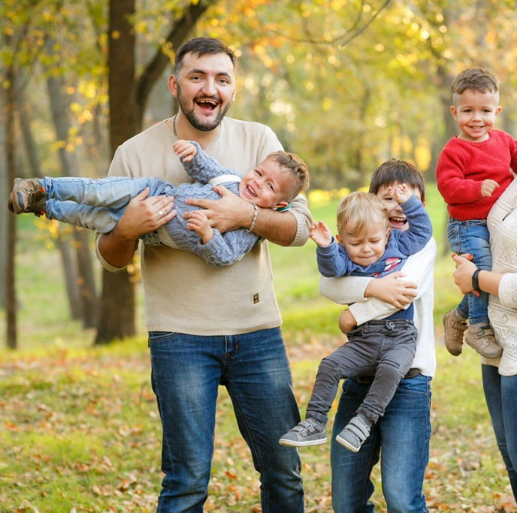
The Journey we dreamt of

Slide 13
Seeing with Fresh Eyes
Redirecting
Parents & Caregivers for Wellness

Slide 14
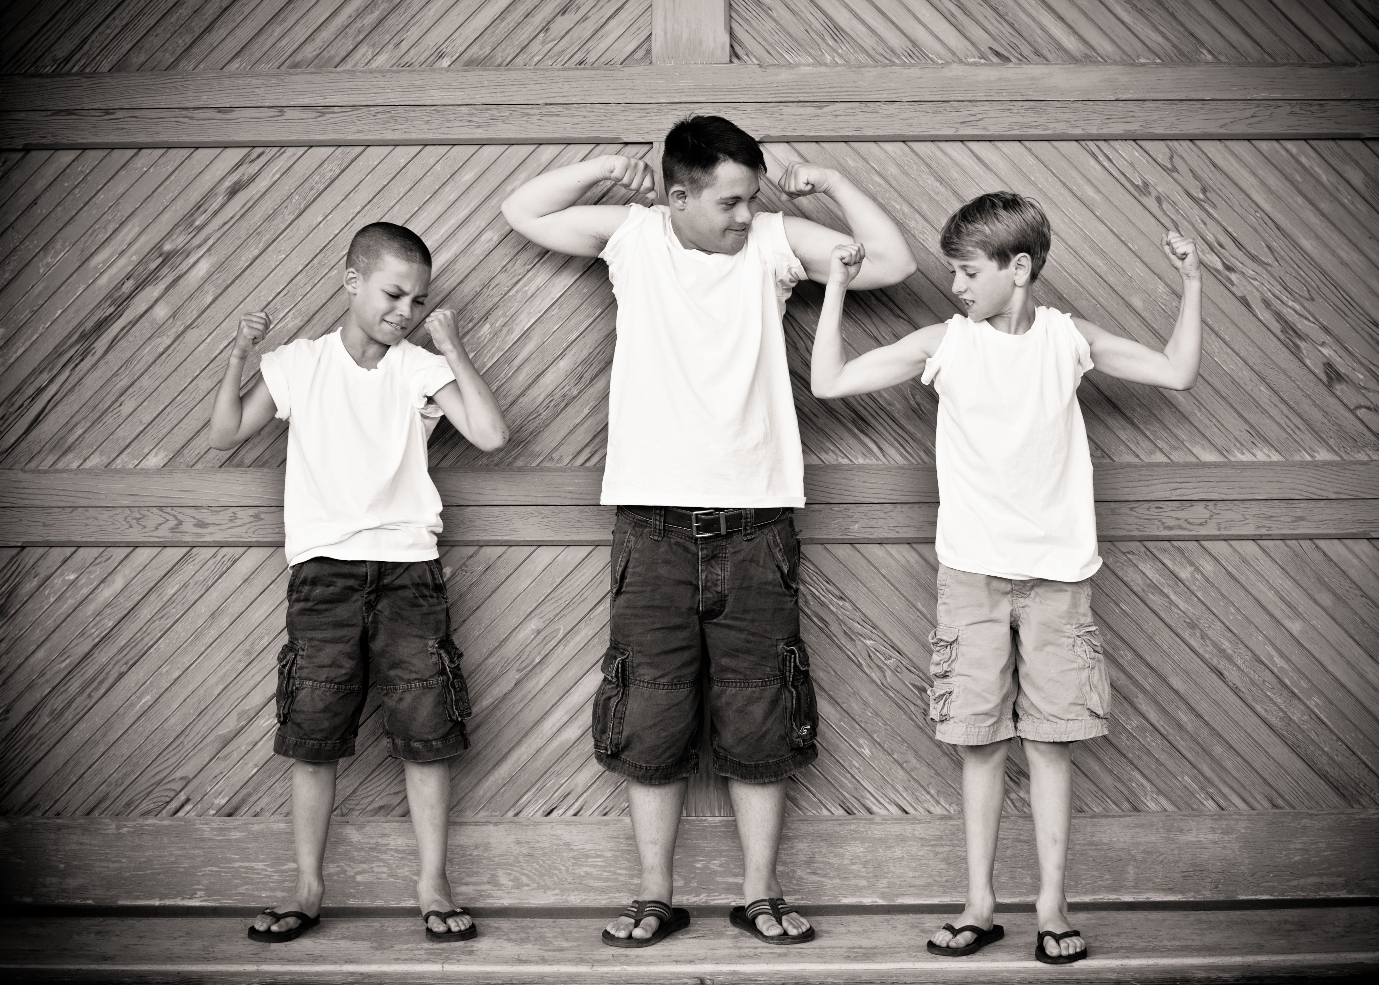
The Journey Rerouted
Depression
Violence
Anorexia
Trauma
Autism
School Dropout
Down Syndrome
Residential Treatment
Life Altering Anxiety
Bipolar Disorder

Slide 15
Sensing
Letting Go of What Was
Letting Go of What Isn’t Working
Parents & Caregivers for Wellness

Slide 17
Presencing
Connecting to Source
Inspiration
Common Good
Common Interest
Parents & Caregivers for Wellness

Slide 19
Crystallizing
Vision & Intention
Balance within the Family

Slide 20
Family
Good Memories
True Appreciation
Peace
Balance

Slide 21
ProtoTyping
Integrating Head, Heart & Hand
Creating Model
Parents & Caregivers for Wellness

Slide 22
Family Balance Components
Hand
Head
Balance Looks Like
Heart

Slide 23
Performing
Operating from the Whole Family System
Parents & Caregivers for Wellness

Slide 24
Practice Practice Practice
Check-IN with Yourself and Your family- Is your prototype working?
Be flexible-
If something isn’t working, Change it
Progress over perfection….
functional happiness is the goal

