Slide 1
Notes:
Chart showing ages of reportable (“Y”) versus not reportable (“N”) upon discovery of sexual intercourse

Slide 2
KidsFirst Counseling and Family Resource Centers Child Abuse Prevention Council

Slide 3
Mike Mason
Community Development
& Communications
mmason@kidsfirstnow.org

Slide 4
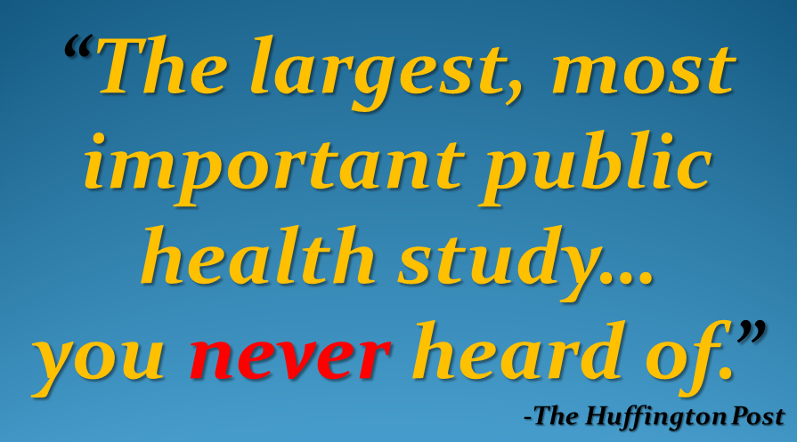

Slide 5
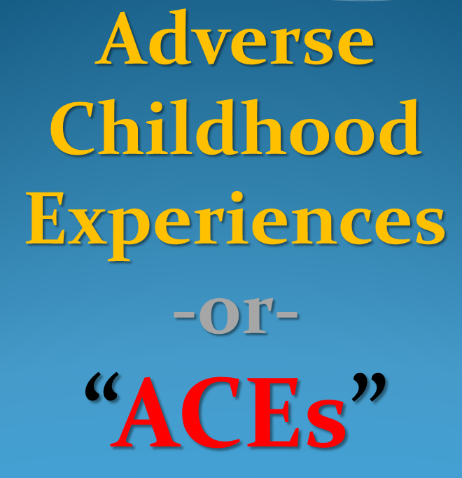

Slide 6
Penicillin, X-Rays & ACEs:
Accidental Discovery of ACEs is Changing our View of Health​

Slide 7
CDC…annual cost of patients who have a history of
early (childhood) trauma is…
$124 Billion a year

Slide 8
-or-
7
Paradise
“Camp Fires”
EVERY
SINGLE
YEAR

Slide 9
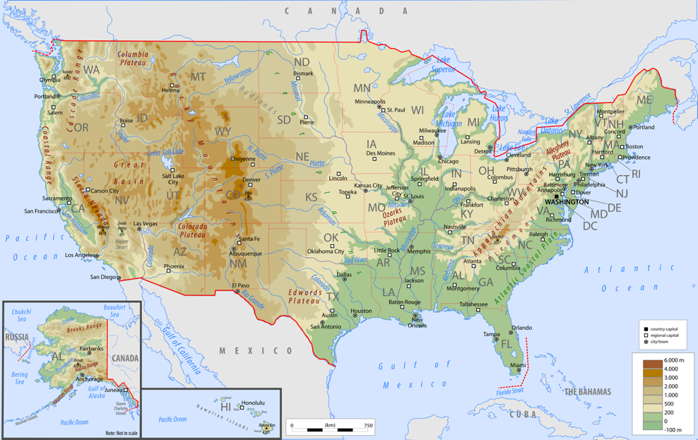
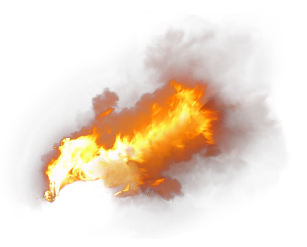
Notes:
She was in the care of a family when a church worker found her: skinny, bruised & unkempt.

Slide 10
Annual costs includes:
childhood health
adult medical
work productivity loss
child welfare
criminal justice
special education
social services*
*Million Dollar Murray (Gladwell)
Notes:
She was in the care of a family when a church worker found her: skinny, bruised & unkempt.

Slide 11
ACEs Cost Us…
Lots of $$
Shorter lives
Loss of life quality

Slide 13
1985
Kaiser Permanente
Obesity Clinic
San Diego
Dr. Vincent Felitti
In a 5 year period…
Over HALF of the weight-loss participants dropped out…
Despite weight loss successes

Slide 14
He investigated…
Types of questions posed to former clinic participants…
How much did you weigh when you
were born?
How much did you weigh when you started high school?
How much did you weigh when you
got married?

Slide 15
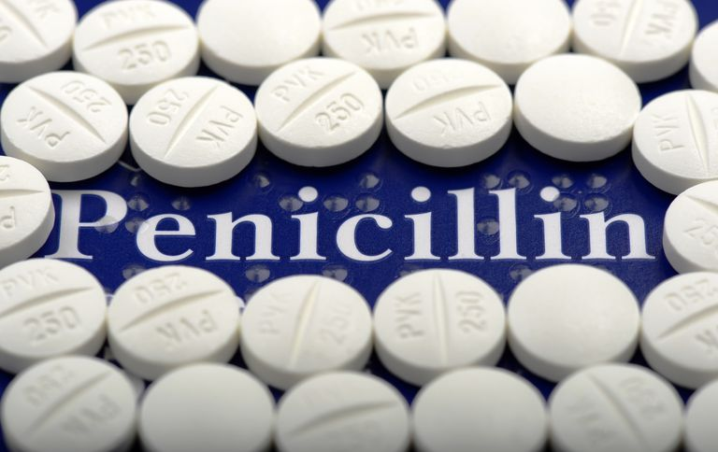
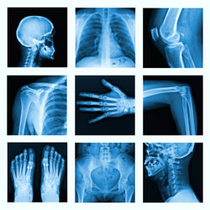
Then mistakenly….

Slide 16
How much did you weigh when you first became sexually active?

Slide 17
Many of the answers shocked Dr. Felitti
MANY of the adult program “drop-outs” had been sexually abused as children

Slide 18
These responses jumpstarted deep investigations.

Slide 19
1995 - 1997
Center for Disease Control
+
Kaiser Permanente
Surveyed
17,000 participants

Slide 20
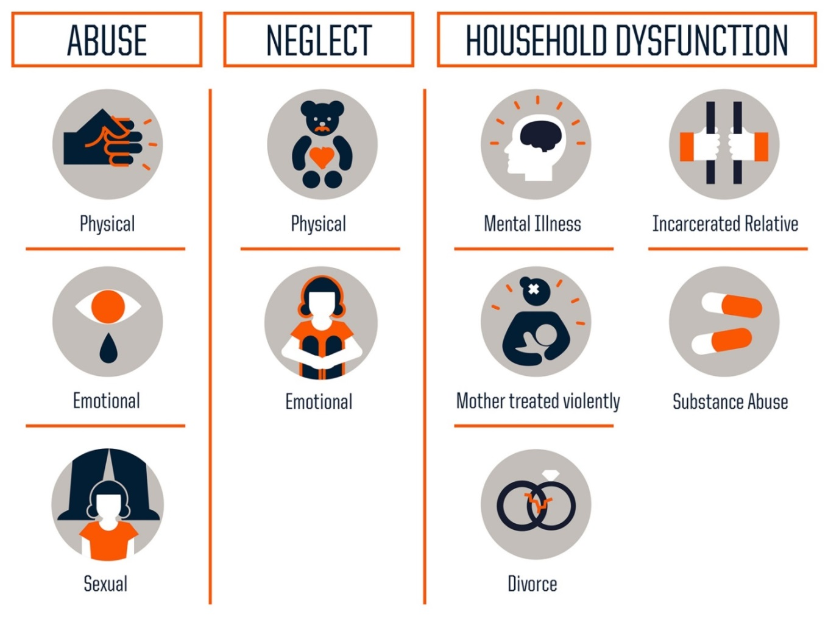
10 Types
Adverse Childhood Experiences

Slide 21
Key findings…
Adverse Childhood Experiences:
Vastly more common than recognized or acknowledged
Powerful relation to adult health…even 50 years later

Slide 22
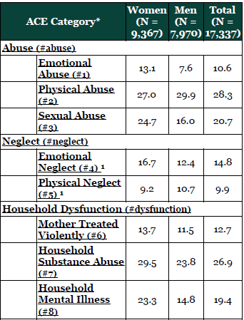
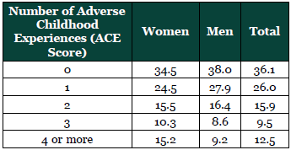

Slide 23
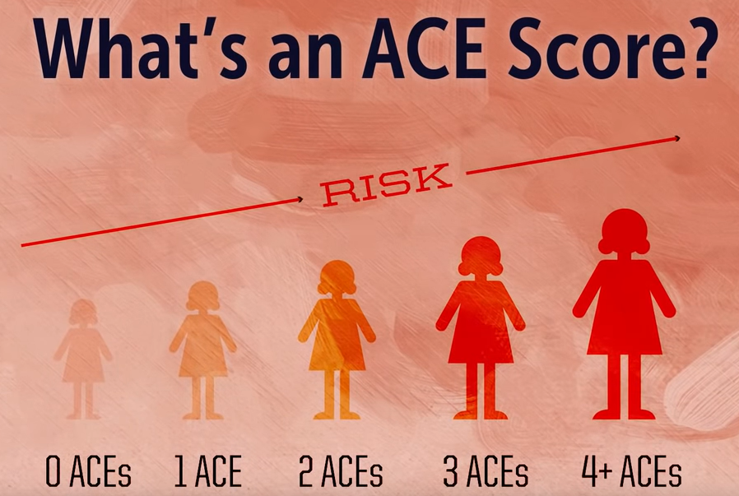

Slide 24
4 or more ACEs
7 x more likely to be an alcoholic
10 x more likely to inject street drugs
12 x more likely to attempt suicide
more violent…..more marriages…..
more broken bones more Rx…..more depression
more auto-immune disease…..more work absences

Slide 25
Study was NOT done in the inner city of Philadelphia (for instance)
It was done in San Diego, CA…
UNDER-REPORTED
Factor
White
Middle Class
Mostly Educated

Slide 26
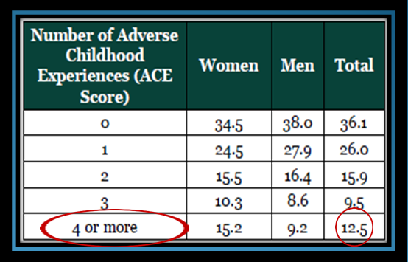
If this is
San Diego…
…what’s happening elsewhere?

Slide 27
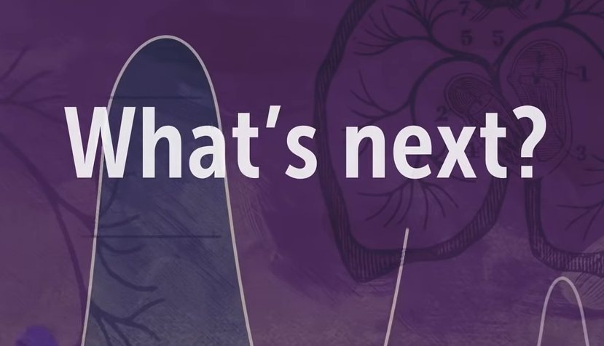

Slide 28
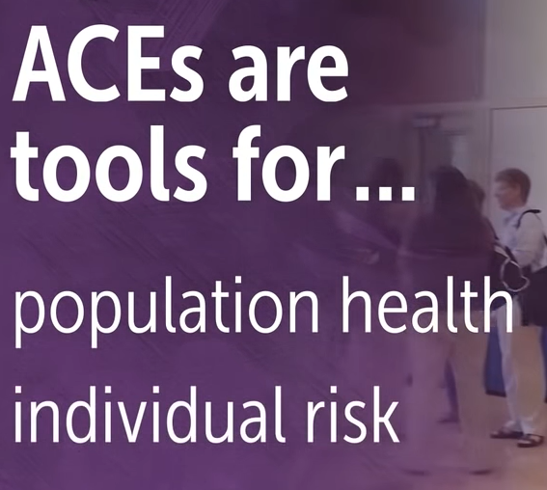

Slide 29
Inform
Educate
Encourage

Slide 30
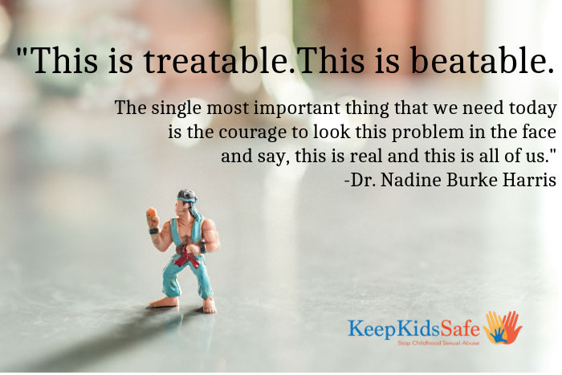
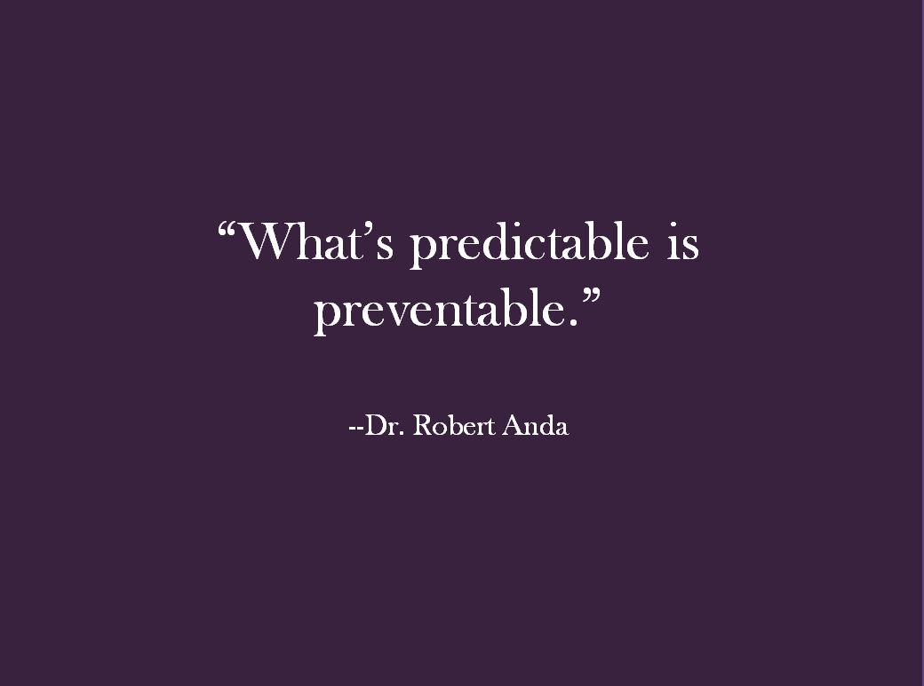

Slide 31
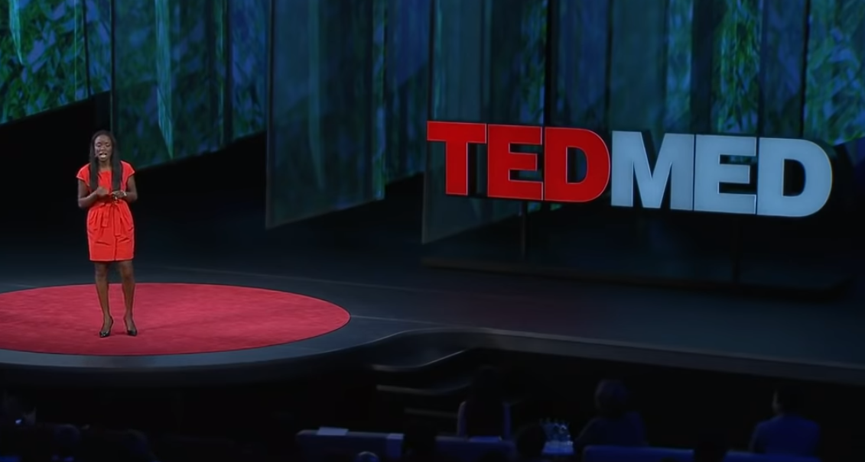
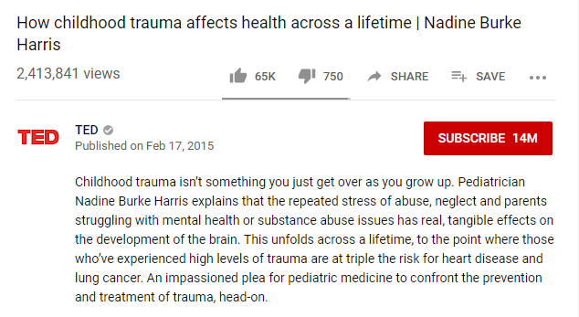

Slide 32
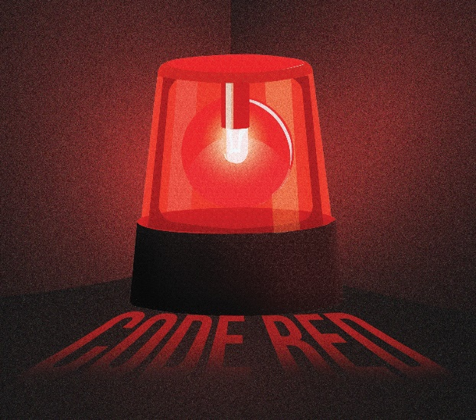
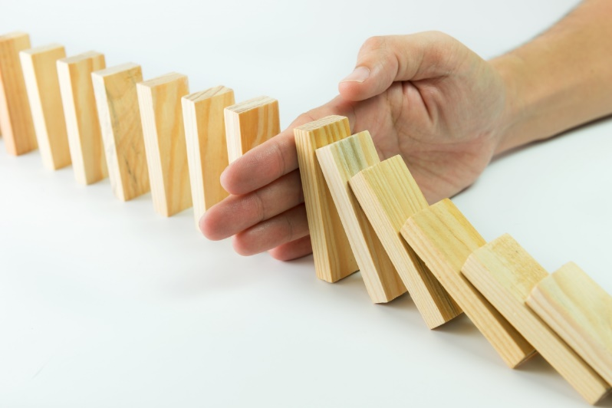
Stark
Warnings
-or-
Preventable
Paths​

Slide 33
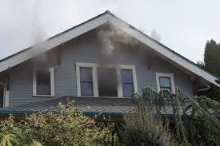
“What we have learned in the ACE Study represents the underlying fire in medical practice where we often treat symptoms rather than underlying causes.”
-Dr. Felitti

Slide 34
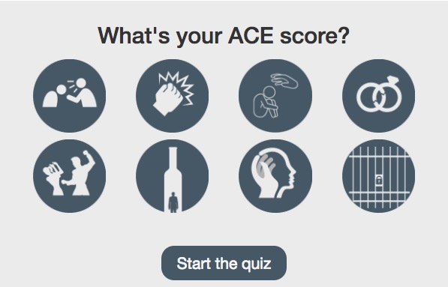

Slide 36
Racism
Bullying
Homeless
Living in a war zone
Being an immigrant
Moving many times
Witness sibling being abused
Losing a parent to deportation
Involvement in foster care system
Living in an unsafe neighborhood
Attending a zero-tolerance school
Witness violence outside the home
Witness father /caregiver being abused
Involvement in criminal justice system
Add’l ACEs
may include

Slide 37
Who is most vulnerable ?

Slide 38
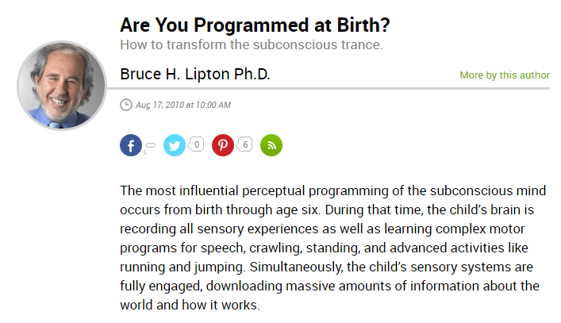

Slide 39
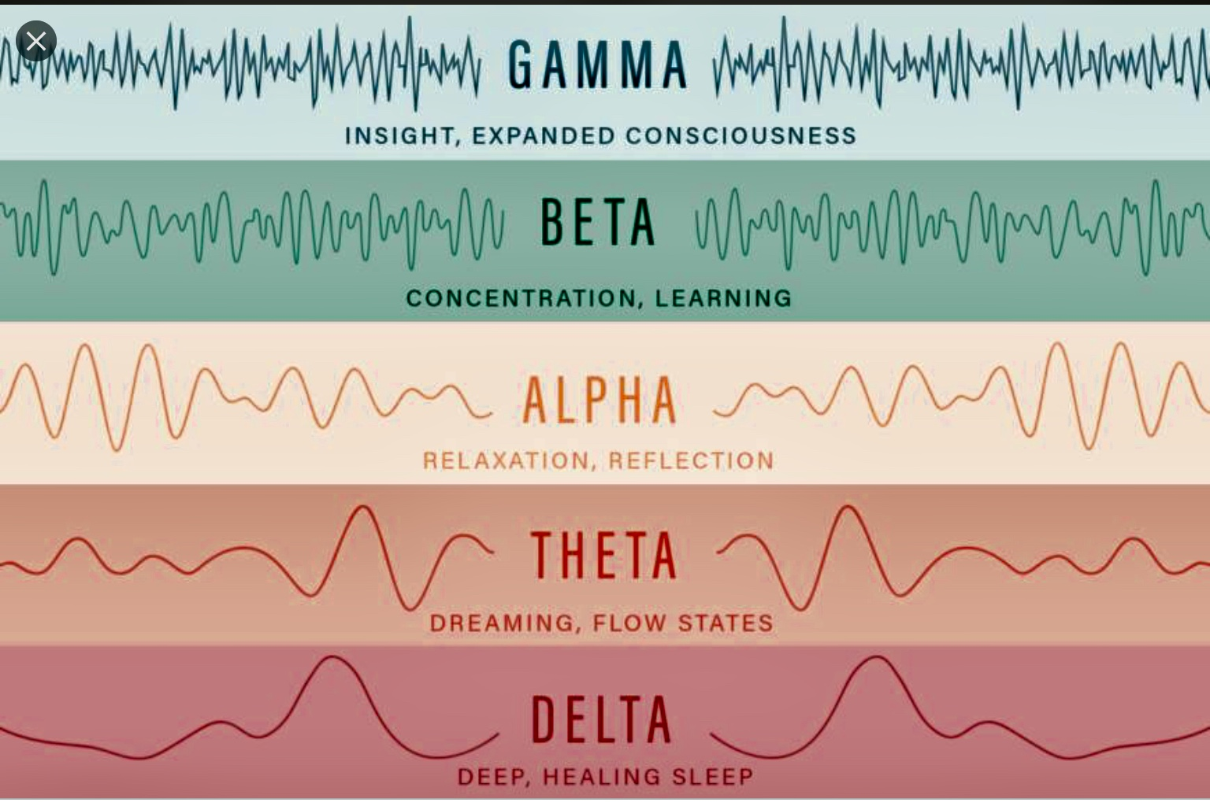

Slide 40
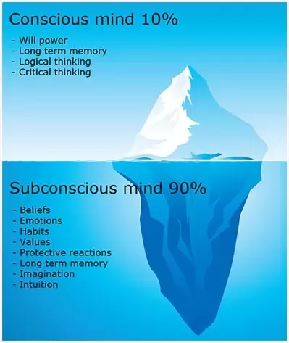

Slide 42
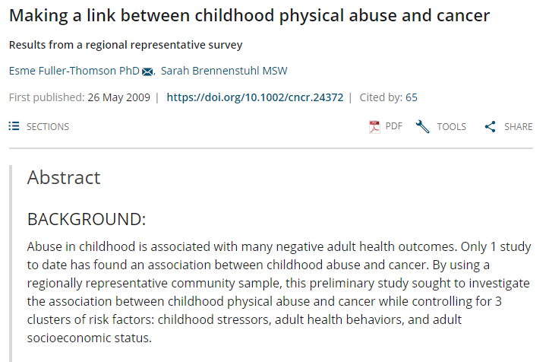
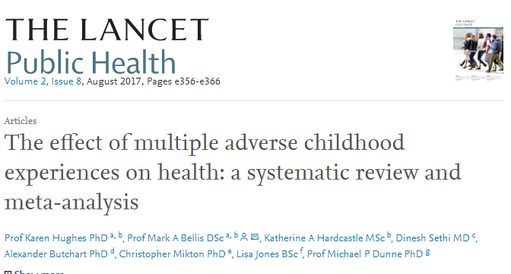
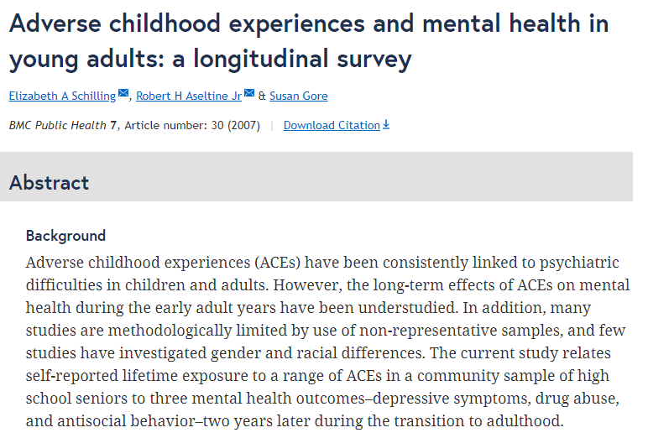

Slide 43
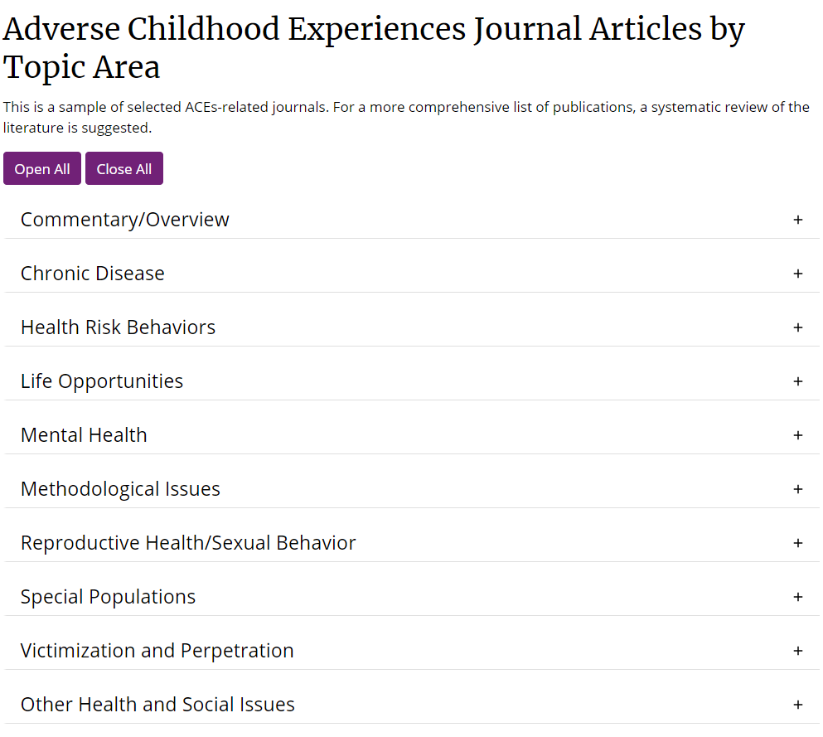

Slide 45
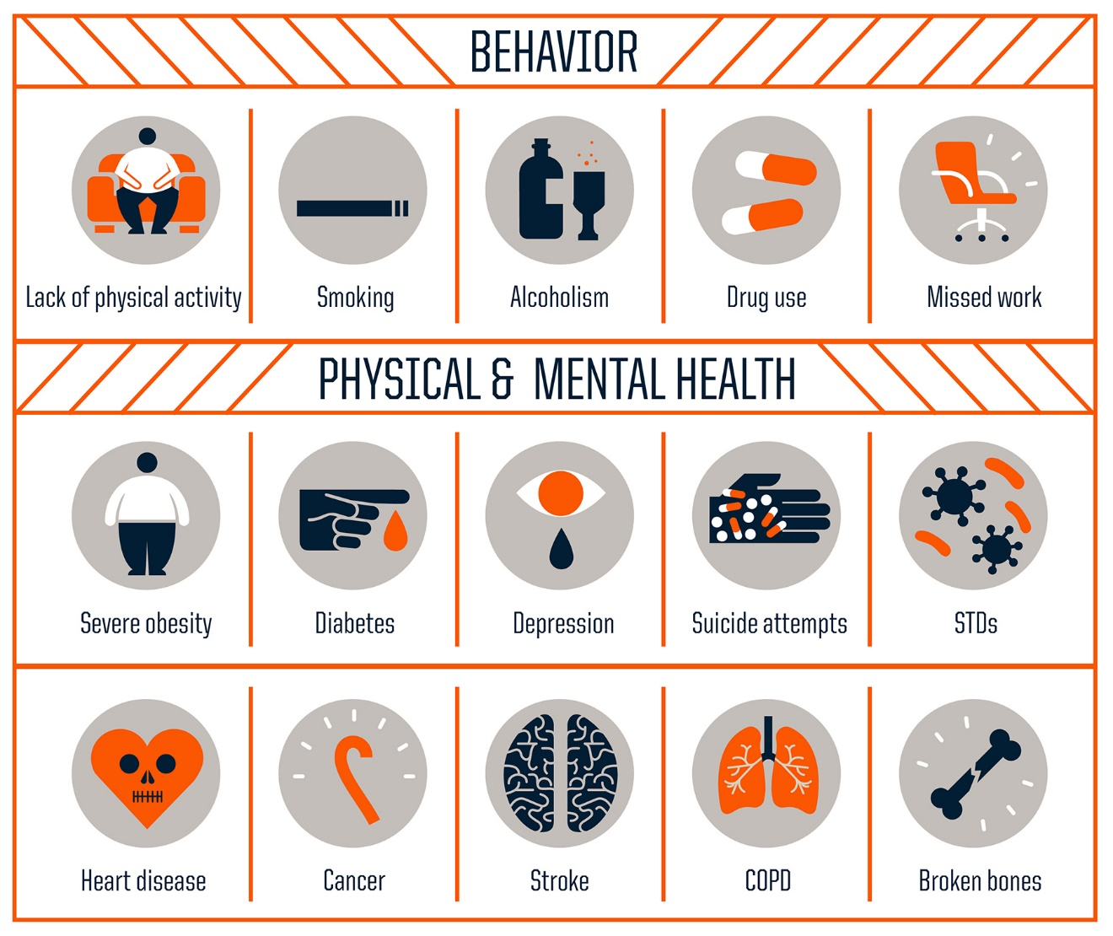
Possible Risk Outcomes

Slide 46
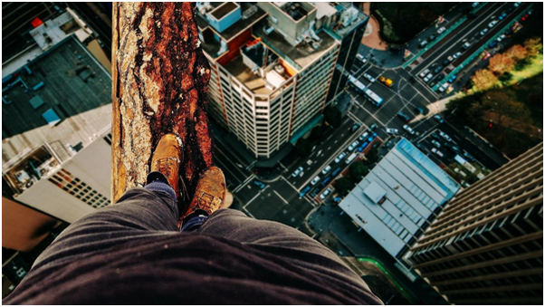
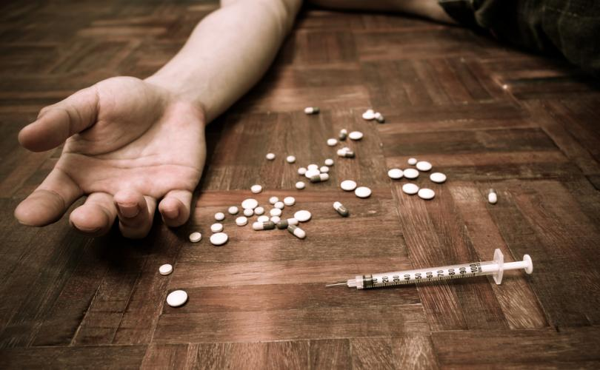
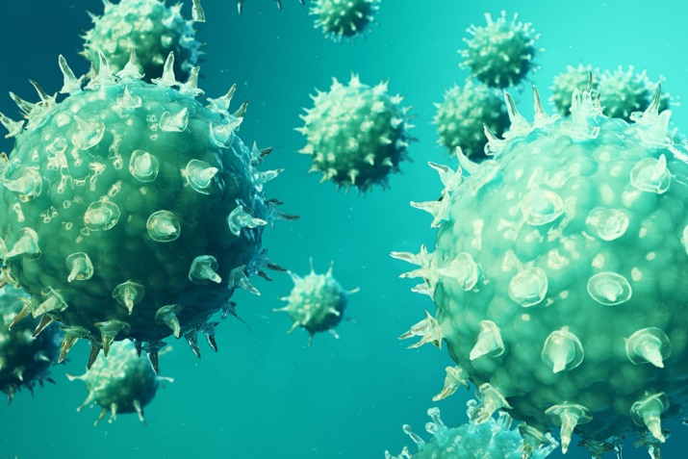

Slide 47
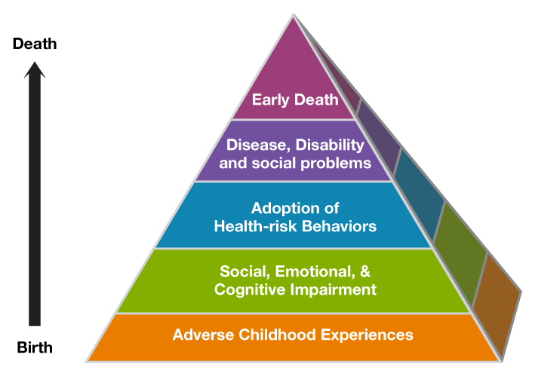

Slide 48
How? What is going on in the body?
“…research has reported that anxiety and behavioral responses to stress involve complex neural circuits and multiple neurochemical components. Acute and chronic stress due to abuse can alter these circuits, their neurochemical components, and (organ) function.”

Slide 49
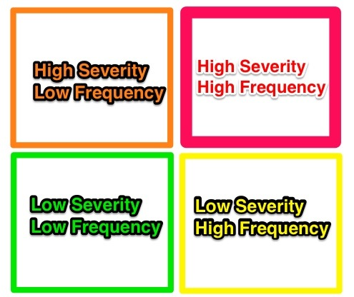
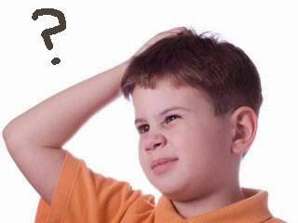
ACE Study has been challenged…

Slide 50
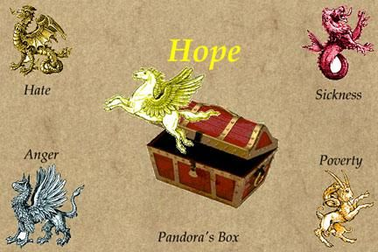

Slide 51
Education
Law enforcement
Social services
Employers

Slide 52
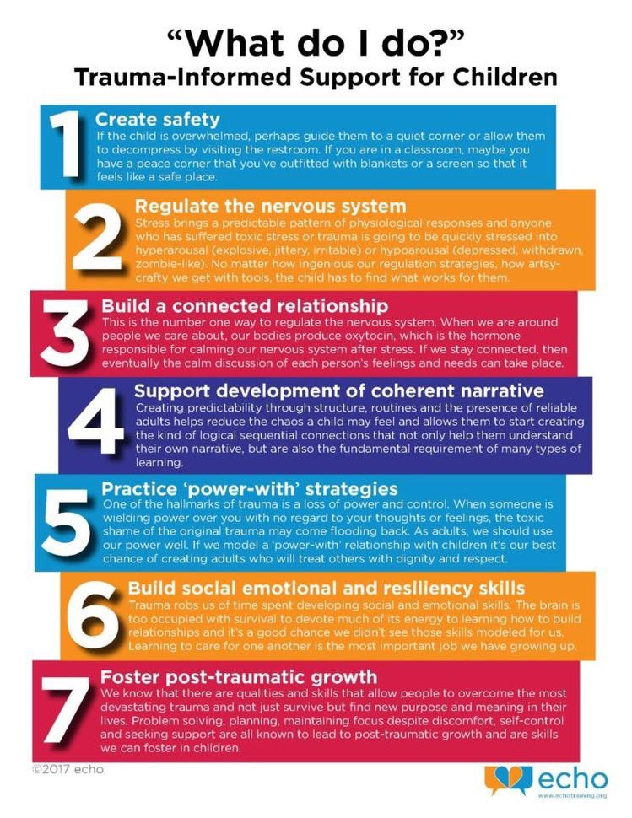
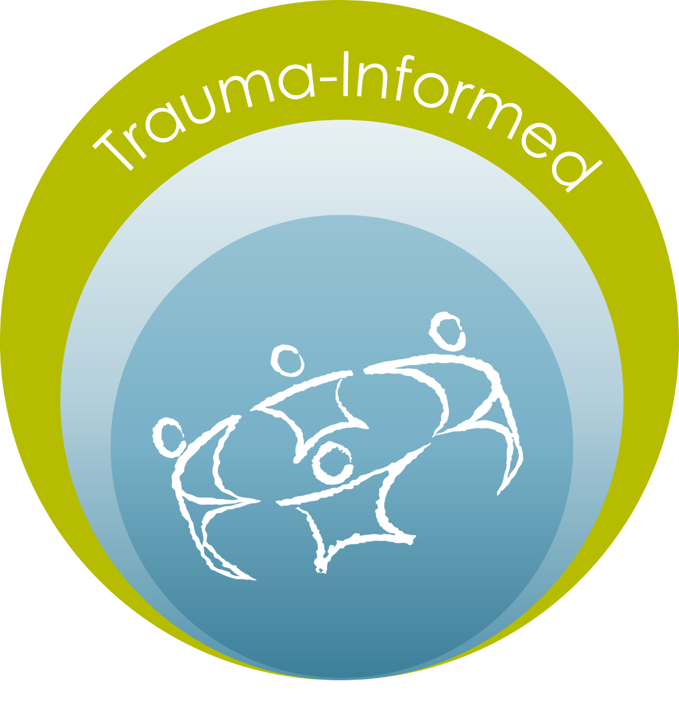
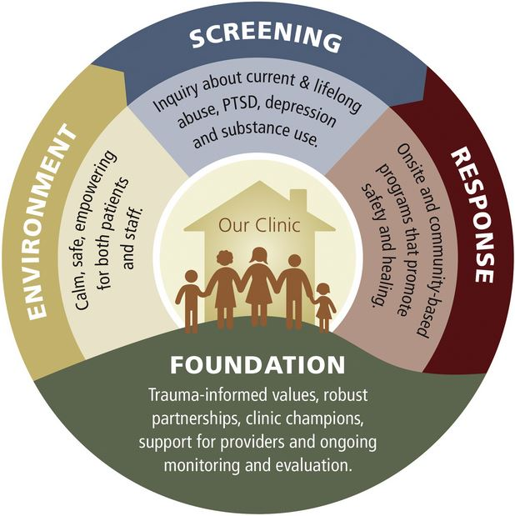
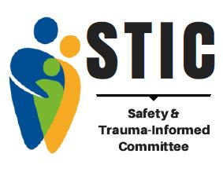
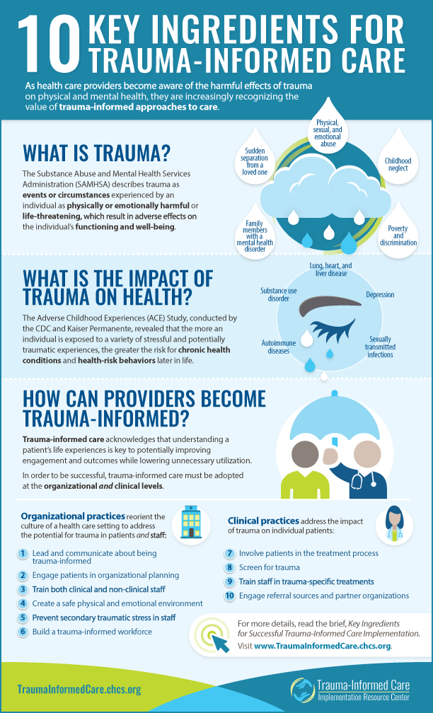
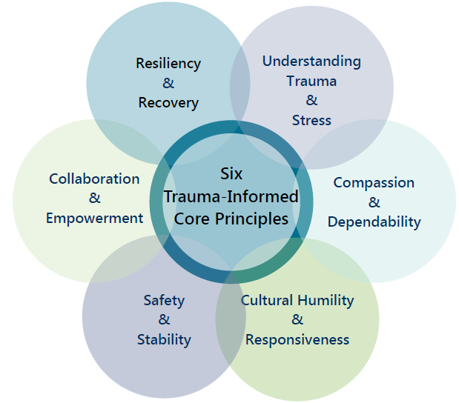

Slide 53
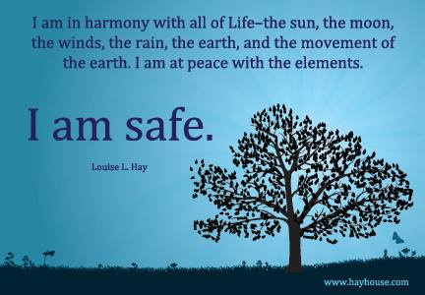
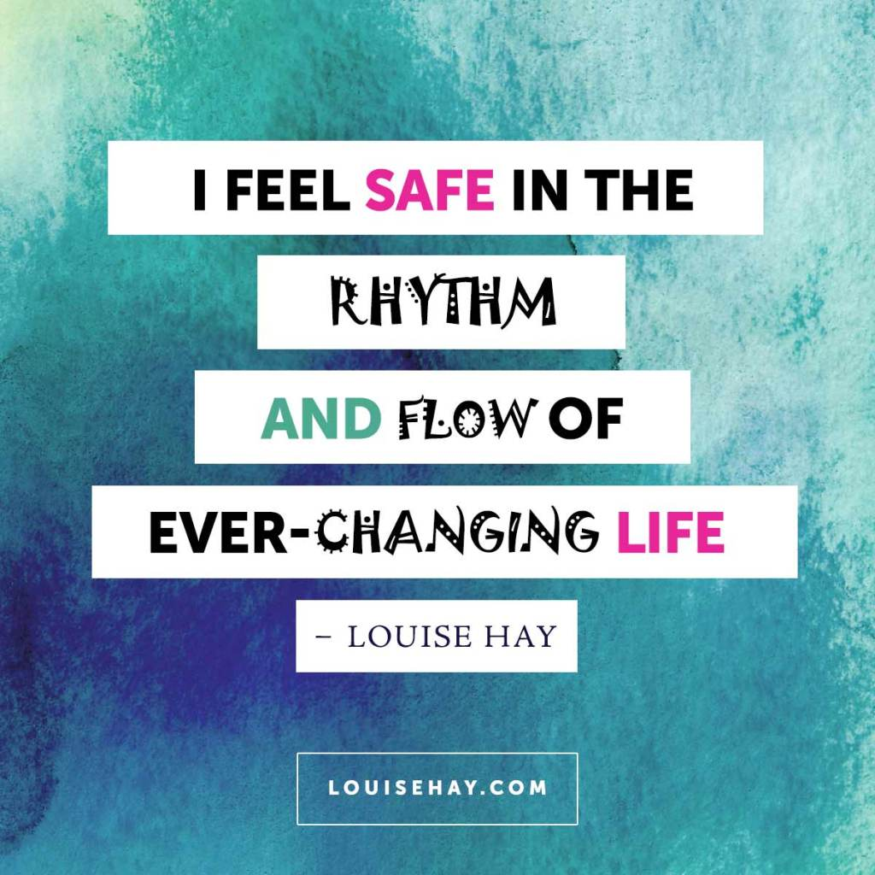
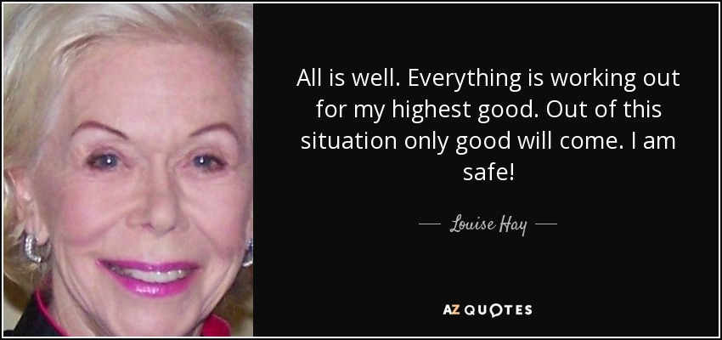
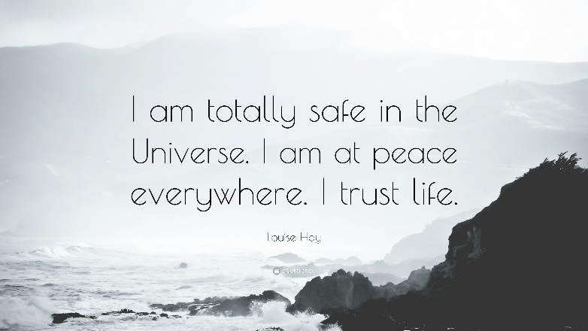

Slide 55
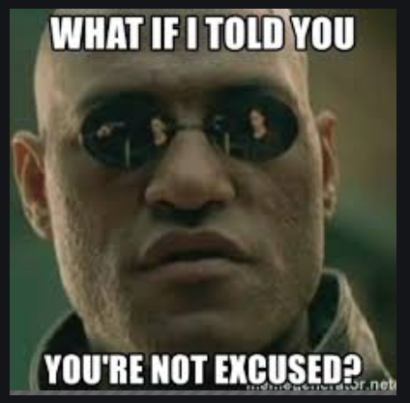

Slide 57
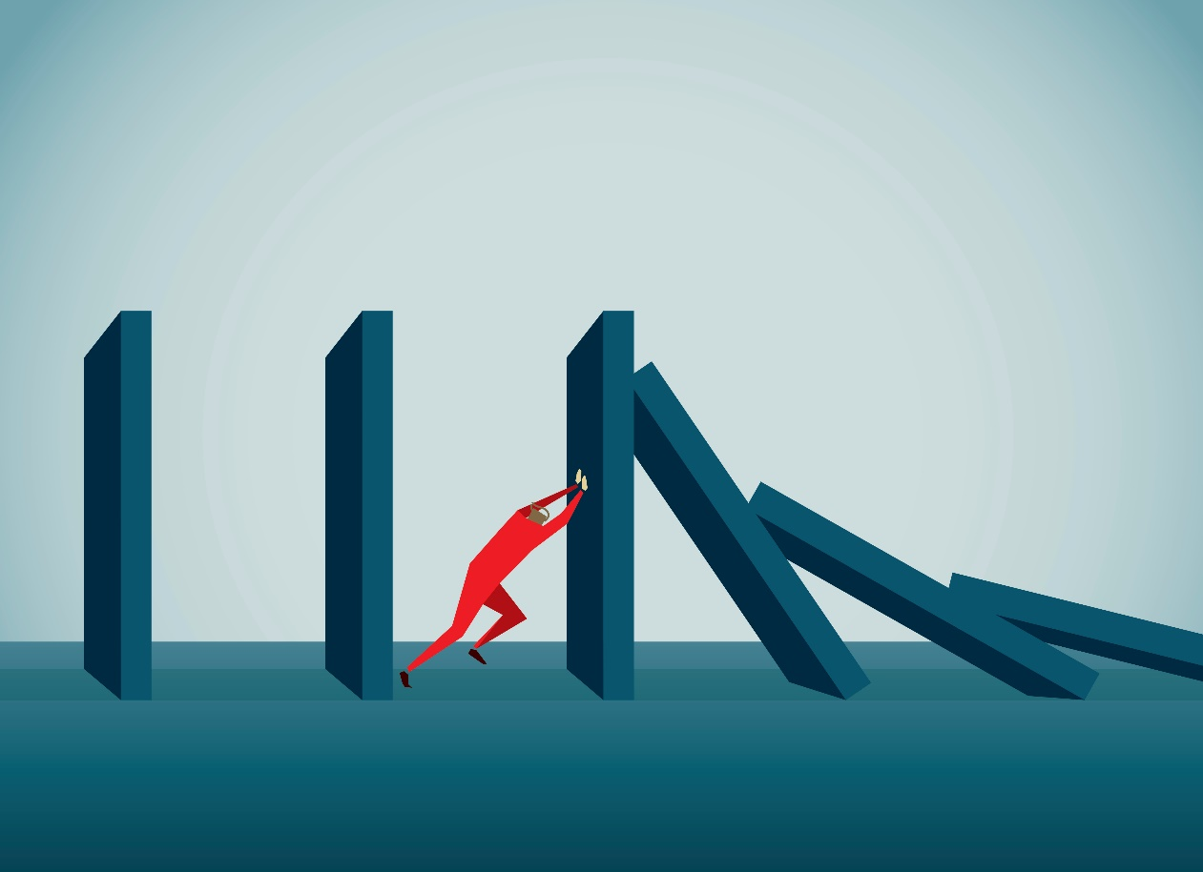

Slide 59
8 ways people recover from post childhood adversity syndrome
1. Take the ACE questionnaire
2. Begin writing to heal
4. Yoga
5. Therapy
6. EEG neurofeedback
7. EMDR therapy
8. Rally community healing
You’re not alone

Slide 60
