Slide 1
Penicillin, X-Rays & ACEs The Accidental discovery of ACEs is changing our view of health

Slide 2
Mike Mason
Community Development
& Communications
mmason@kidsfirstnow.org

Slide 3
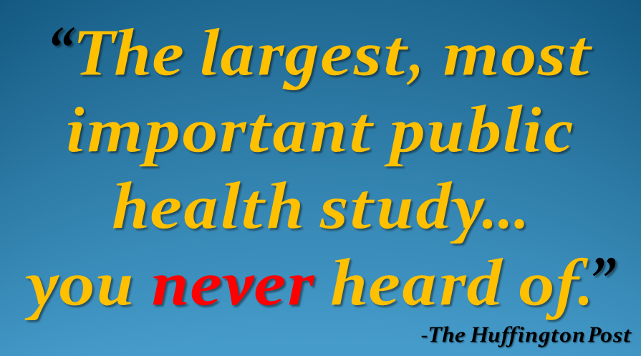

Slide 4
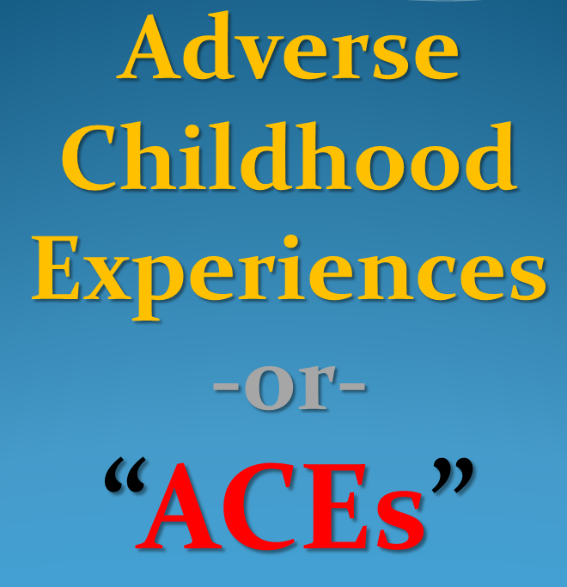

Slide 5
Penicillin, X-Rays & ACEs:
Accidental Discovery of ACEs is Changing our View of Health​

Slide 6
CDC…annual cost of patients who have a history of
early (childhood) trauma is…
$124 Billion a year

Slide 7
-or-
7
Paradise
“Camp Fires”
EVERY
SINGLE
YEAR

Slide 8
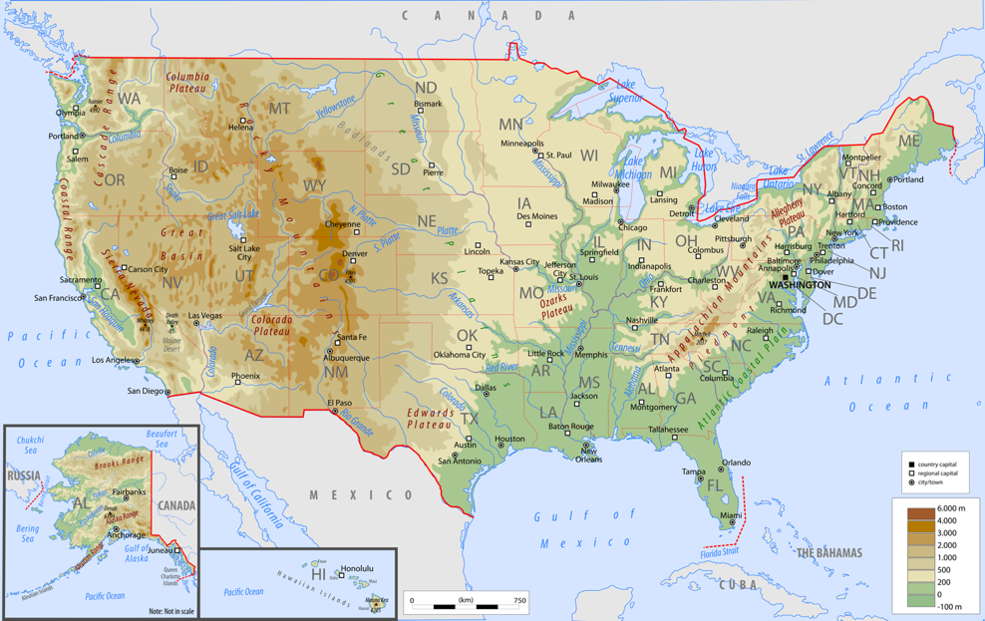
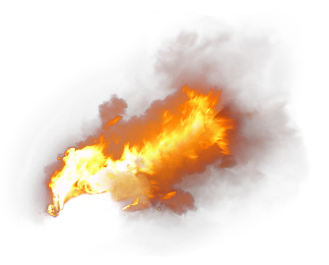
Notes:
She was in the care of a family when a church worker found her: skinny, bruised & unkempt.

Slide 9
Annual costs includes:
childhood health
adult medical
work productivity loss
child welfare
criminal justice
special education
social services*
*Million Dollar Murray (Gladwell)
Notes:
She was in the care of a family when a church worker found her: skinny, bruised & unkempt.

Slide 10
ACEs Cost Us…
Lots of $$
Shorter lives
Loss of life quality

Slide 12
1985
Kaiser Permanente
Obesity Clinic
San Diego
Dr. Vincent Felitti
In a 5 year period…
Over HALF of the weight-loss participants dropped out…
Despite weight loss successes

Slide 13
He investigated…
Types of questions posed to former clinic participants…
How much did you weigh when you
were born?
How much did you weigh when you started high school?
How much did you weigh when you
got married?

Slide 14
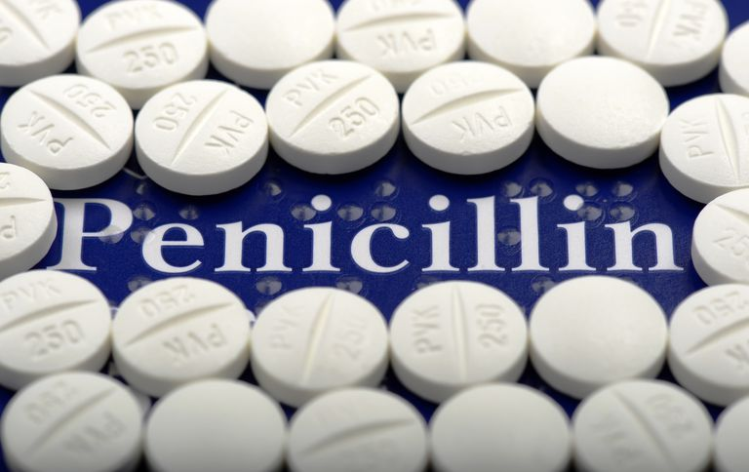
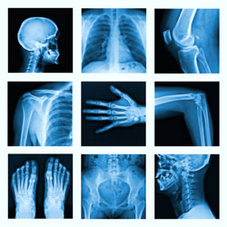
Then mistakenly….

Slide 15
How much did you weigh when you first became sexually active?

Slide 16
Many of the answers shocked Dr. Felitti
MANY of the adult program “drop-outs” had been sexually abused as children

Slide 17
These responses jumpstarted deep investigations.

Slide 18
1995 - 1997
Center for Disease Control
+
Kaiser Permanente
Surveyed
17,000 participants

Slide 19
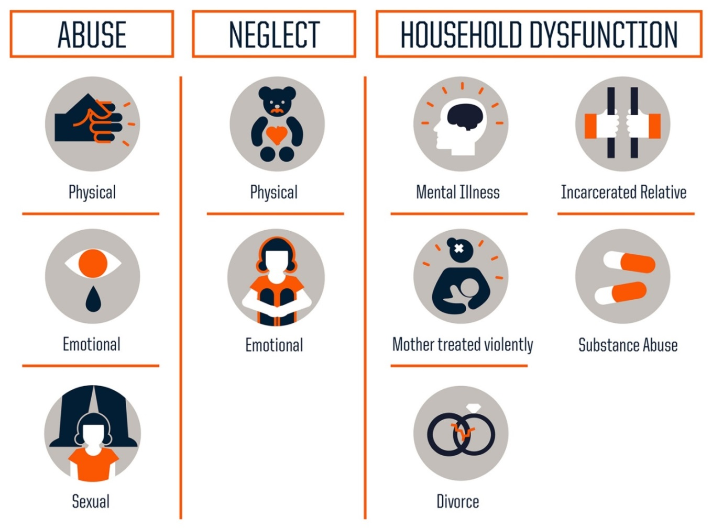
10 Types
Adverse Childhood Experiences

Slide 20
Key findings…
Adverse Childhood Experiences:
Vastly more common than recognized or acknowledged
Powerful relation to adult health…even a 50 years later

Slide 21
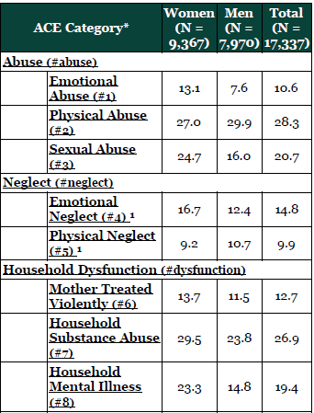
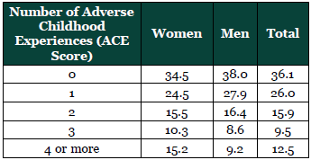

Slide 22
4 or more ACEs
7 x more likely to be an alcoholic
10 x more likely to inject street drugs
12 x more likely to attempt suicide
more violent…..more marriages…..
more broken bones more Rx…..more depression
more auto-immune disease…..more work absences

Slide 23
Study was NOT done in the inner city of Philadelphia (for instance)
It was done in San Diego, CA…
UNDER-REPORTED
Factor
White
Middle Class
Mostly Educated

Slide 24
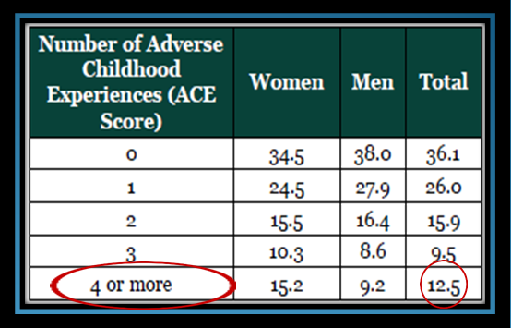
If this is
San Diego…
…what’s happening elsewhere?

Slide 26
Inform
Educate
Encourage

Slide 27
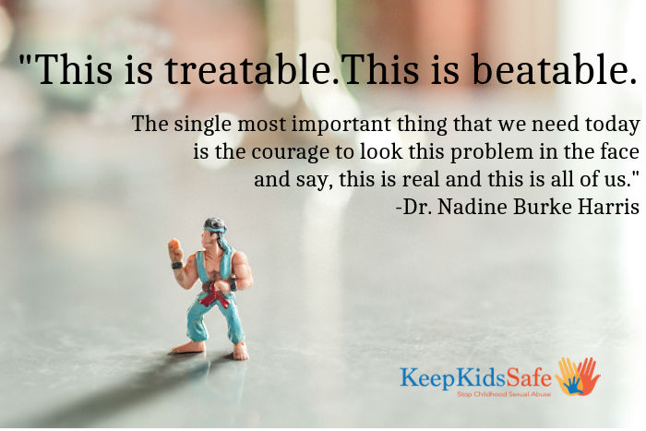
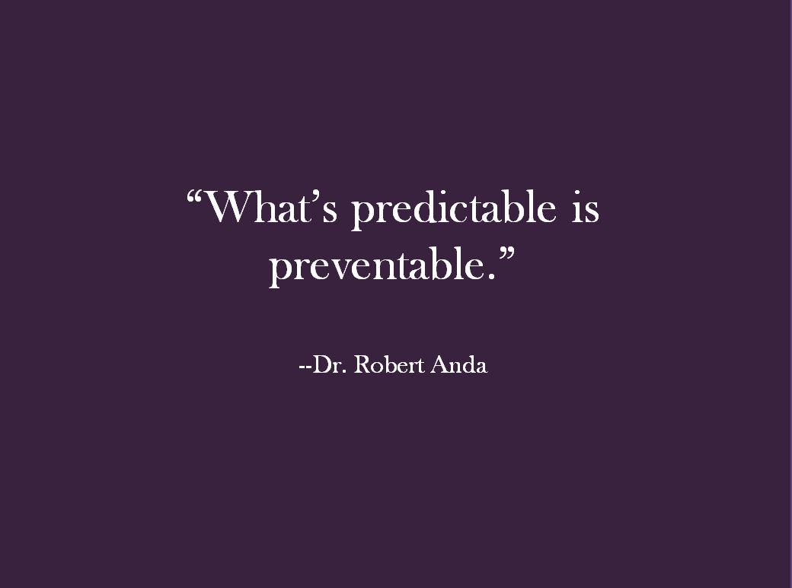

Slide 28
